Slide 1
Welcome
to Room 27
Mrs. Dallosta
Notes:
This template can be used as a starter file for a photo album.

Slide 2
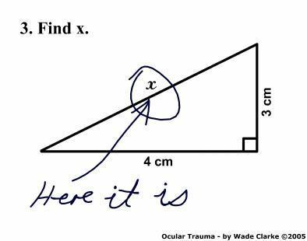
Mathematics:
Everyday Mathematics- McGraw Hill. A research-based curriculum that connects math to everyday situations by encouraging creativity, building conceptual understanding and developing depth of knowledge with carefully engineered spiraling and focused instruction.
-Math spiral for notes and practice
-Pencil only
-Self correct homework with
red each night so they can ask
for help the following day
-Homework typically every
Monday-Thursday

Slide 3
Science:
FOSS. Investigate, learn about, and link science to other curriculum areas. Units include water planet, mixtures and solutions, and transport systems of the body .

Slide 4
Language Arts:
Piloting Programs. -Benchmark Advance
-McGraw Hill Wonders
Both are integrated reading, writing, spelling, & grammar programs.
Daily journal writing.
Read to Self- self-selected novels-
40 book Challenge
. Book Reports
Teacher Read Alouds

Slide 5
SOCIAL STUDIES:
Scott Foresman. Our Nation. Units include:
-Native Americans,
-Exploration,
-Colonization,
-Revolutionary War,
-the Constitution,
-Westward Movement,
-States and Capitals.

Slide 6
Our Class Environment
-We follow class expectations
Listen to instruction
Enter and exit prepared
Always try our best
Respect each other and ourself
No excuses
-PILOT position
-Growth Mindset Not Fixed

Slide 7
Expectations
-8:28 Class is lining up, preparing for day
-8:30 Class instruction begins
-Recess is time for snack and bathroom break, then play
-Use of planner
-Responsibility of taking needed materials to and from class- Green work folder, planner, and self selected book
-After school- go to front or by bus area if waiting for a ride- no hanging out

Slide 8
Consequences
Since all expectations are practiced throughout the next few weeks, all students are expected to understand and follow the procedures and rules.
If procedures are not followed we practice again as a whole class.
We may move up or down on number line and in group points
Warnings, Removal from activity or group, ODR slip

Slide 9
PBIS School
Positive Behavior Interventions and Supports (PBIS) is a proactive approach to establishing the behavioral supports and social culture needed for all students in a school to achieve social, emotional and academic success.
Talon Tickets

Slide 10
Rewards
Class Number line- whole class
Group points- small group
Class Dojo & Talon Tickets-individual

Slide 11
Class Dojo
Students earn and lose points throughout the day
Positive Negative
-Doing job -Talking/blurting
-Being safe -Giving up
-Perseverance -Unprepared/no homework
-Teamwork -Hands touching others
-Being kind -Bathroom break (no pass left)
-Lesson explanation -Bullying behaviors
-School spirit -Showing disrespect
-Extra credit -Out of seat/off task
-All Homework In

Slide 12
Other Programs:
Band - Tuesday and Friday with Mrs. Kuersten -optional, but encouraged
Library – Thursday
Spanish-Tuesday and Thursday
Computers - In class use and weekly trips to lab, Chromebooks shared with other classes
Google Classroom- student google accounts provided by district
PE - Monday and Tuesday, tennis shoes please these days
Fine Arts - Art docent program by parent volunteer
Study Skills and Organization- Work Folder (green), Work in Progress Folder (yellow, stays at school), Pass backs (red, student’s responsibility to have it back by the following Friday), spiral for each subject, composition book for journaling
Study Hall- Monday afternoon
Chorus (before school once a week), Cross Country (fall), Track (spring), Green Team (gardening)

Slide 13
Homework and Daily Planner:
Read nightly for 20-30 minutes minimum of 5 times per week- no log, but there will be occasional book reports and journaling.
Daily Math Home Practice(Monday-Thursday) self correction expected
Complete any assignments not completed in class.
Additional assignments will be noted on the Homework Board.
Planner should be filled out daily.
Assignments returned and sent home in Red Friday Folders.
Redo slips for poor work quality

Slide 14
Grading Policy and Marks
Five-Ten point grading scale.
Late work - Must be completed within a week for 50% score (F).
Becomes a zero if not completed within a week.
Test Re-dos - Make corrections within reasonable time, science and social studies test must show the book page number for credit
Absent - No penalty, number of days absent to make up work;Folder will be on desk upon return with work inside
No name –can find no name papers posted in corner of wall by door

Slide 15
Independent Contract for absence of 5 days or more- please give a week’s notice for preparation.
Report cards are issued 3 times a year- Standards & grades combined
Missing assignment sheets given almost every Monday for Study Hall
Progress reports specified
on Progress Report Calendar- e-mailed to save
paper
Parent Portal- not only for parents to use, students encouraged to learn how to use since it is a program used throughout high school
Learner Behaviors

Slide 16
Learner Behaviors
Displays a positive attitude
Demonstrates self-directed learning
Completes and returns homework on time
Follows verbal and/or written directions
Takes responsibility for own behavior
Interacts cooperatively and collaboratively
Respects the rights, feelings, and property of others
Uses problem solving strategies as a learner
Perseveres with challenging tasks and assignments
Produces neat, legible work

Slide 17
Study Hall Participant
Today in Study Hall I will…
_____ Clean my desk (Read if held in other class.)
_____ Write about what caused me to get below 75% in Dojo and how I can get it up this week. (Hand the response to the Study Hall teacher and read when completed.
_____ Complete Redos on assignments and turn it into your teacher.
_____ Work on any missing assignments.
_____ Complete any tests or assignments from when I was absent or did not finish during class time.

Slide 18
Conferences
End of 1st Trimester – Nov 4th
November 16-17
End of 2nd Trimester- Mar 3th
March 15- only if needed

Slide 19
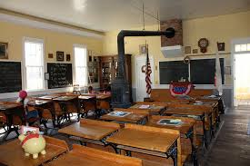
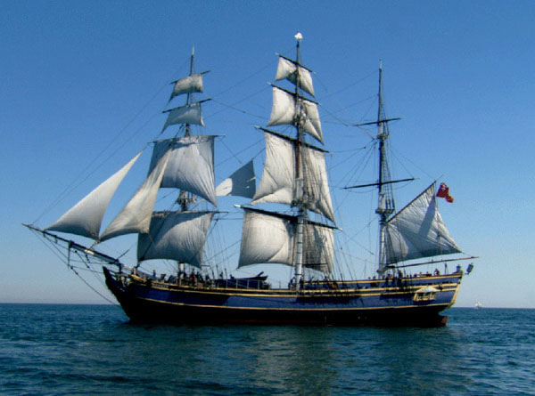
Field Trip:
Tall Ships/Old Schoolhouse in Sacramento- (voluntary $20)
Chaperones must be fingerprinted by 9/30
Guest speakers

Slide 20
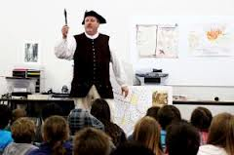
Projects:
State Postcards
President Project using PowerPoint
Sons of the American Revolution poster contest
Inquiry-based assignments
Various other research topics to expand unit of study

Slide 21
Miscellaneous:
Parent Volunteers
Communication- e-mail or Dojo message
Birthday celebrations- treats without soy, coconut, & nuts are welcome
Scholastic Book Club orders - checks payable to Scholastic, due any time, on-line ordering with credit card- CODE: H7XLM
Staff meetings on Mondays after school- difficult time to reach me.

Slide 22
Grade 5
Monday |  | Tuesday |  | Wednesday |  | Thursday |  | Friday
8:30 - 9:15 | ELA | 8:30-9:15 | ELA | 8:30-9:50 | ELA | 8:30-9:50 | ELA | 8:30-9:50 | ELA
9:15 - 9:45 | PE | 9:15 - 9:45 | PE |  | ELA |  | ELA |  | ELA
9:50-10:00 | RECESS | 9:50-10:00 | RECESS | 9:50-10:00 | RECESS | 9:50-10:00 | RECESS | 9:50-10:00 | RECESS
10:00-10:30 | ELA | 10:00-10:30 | ELA | 10:00-10:30 | Library | 10:00-10:30 | ELA | 10:00-10:30 | ELA
10:30-11:30 | Math | 10:00-11:30 | Math | 10:00-11:30 | Math | 10:15-11:30 | Math | 10:00-11:30 | Math
11:30-12:00 | RTI Math | 11:30-12:00 | RTI Math | 11:30-12:00 | RTI Math | 11:30-12:00 | RTI Math | 11:30-12:00 | RTI MAth
12:00-12:40 (40) | LUNCH | 12:00-12:40 (40) | LUNCH | 12:00-12:40 (40) | LUNCH | 12:00-12:40 (40) | LUNCH | 12:00-12:40 (40) | LUNCH
12:40-1:10 | ELA w/RTI support | 12:40-1:10 | Enrichment/ | 12:40-1:10 | ELA w/RTI support | 12:40-1:10 | ELA w/RTI support | 12:40-1:10 | Enrichment/
 | ELA | 12:40 -1:25 | Band |  | ELA |  | ELA | 12:40 - 1:25 | Band
1:15-1:45 | SS/Science | 1:25-1:45 | SS/Science | 1:15-1:45 | SS/Science | 1:15-1:45 | `SS/Science | 1:25-1:45 | SS/Science
1:45 - 2:00 | SS/Science | 1:45 - 2:00 | SS/Science | 1:45 - 2:00 | SS/Science | 1:45 - 2:00 | SS/Science (45) | 1:45 - 2:00 | SS/Science
2:00 - 2:30 | Study Hall | 2:00 - 2:30 | Spanish | 2:00 - 2:30 | SS/Science | 2:00 - 2:30 | Spanish | 2:00 - 2:30 | SS/Science

Slide 23
School Phone: 652-1824 ext 227
E-Mail: edallosta@loomis-usd.k12.ca.us

